Slide 1
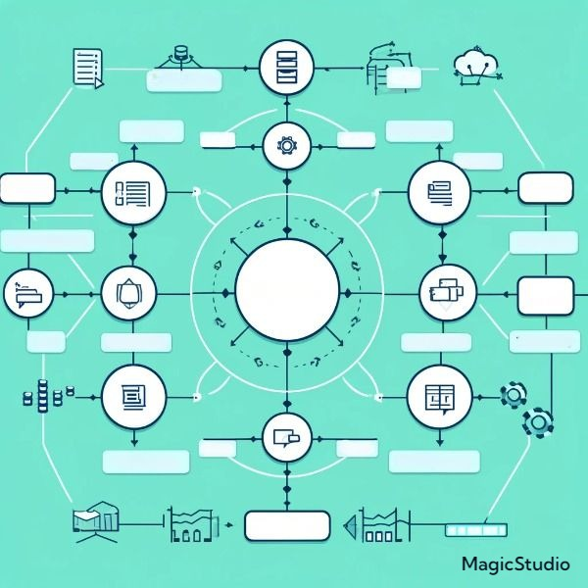
FARMER PROFILES
DATA
DATA STATS
DECISION
PROCESS
DATA SOURCE
DATABASES
COMPLIANCE
DATABASES
POLICIES
DATA GOVERNANCE
DATA ACCESS
SYSTEM INTEGRATION PLATFORM
POLICIES
APIs
DATA INTEGRITY
ENCRYPTION
DATA SECURITY
DATA INTEGRATION
BACKUP
LIFECYCLE
DATA GOVERNANCE
PLACEHOLDER

